Slide 1
CTF model for long reverberation Date：2022. 08. 09
Telecom Electroacoustics Audio(TEA) Lab
Presenter:
Anchi Yuan
Notes:
Hello everyone
I’m today’s presenter siang. I’m going to share some of my present work in source separation problem. My topic is comparative studies of source separation using semi-blind and blind source separation approaches.

Slide 2
Outline
Key modification for estimating ATF
Simulation setting
Simulation result
Problem for blind estimation

Slide 3
Key modification for estimating ATF
Adding delay to microphone signal
Using impulse signal to reconstruct RIR from CTF coefficient
Extracting initial source signal from WPE

Slide 4
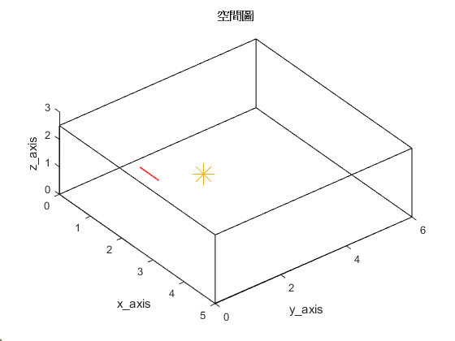
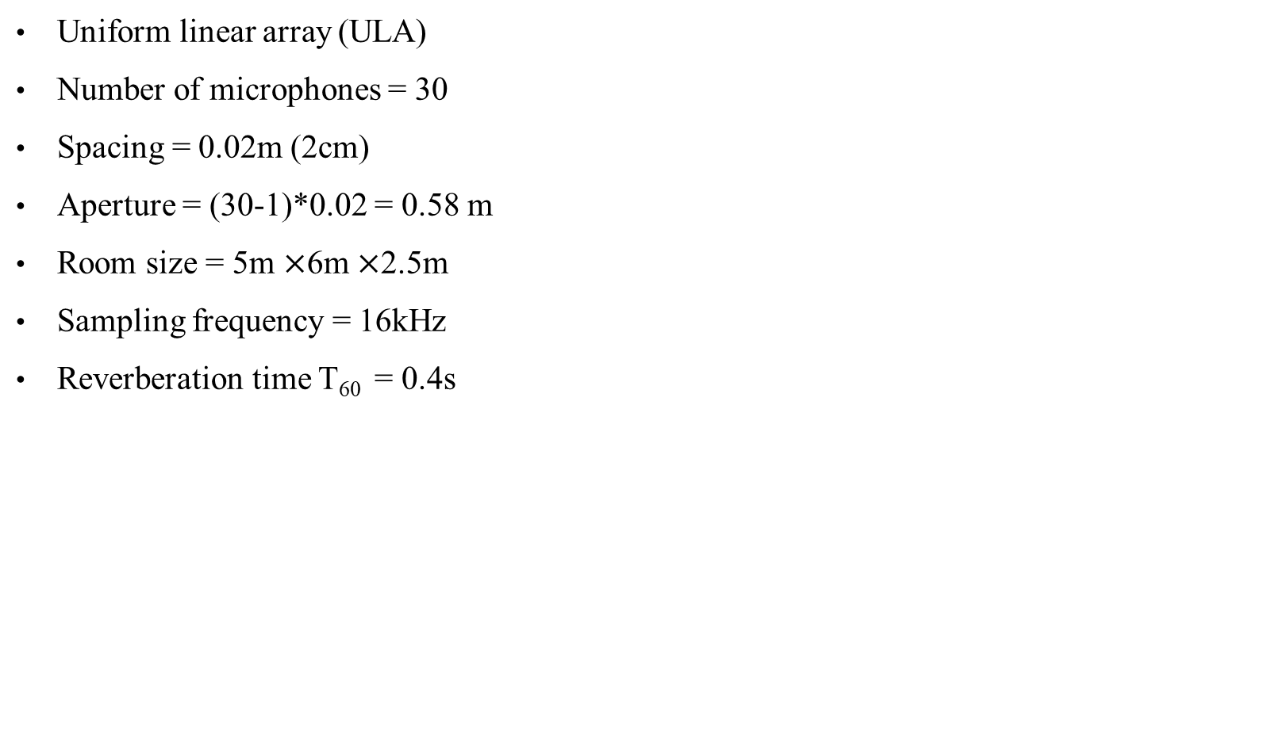
Simulation setting
Uniform linear array (ULA)
Number of microphones = 30
Spacing = 0.02m (2cm)
Aperture = (30-1)*0.02 = 0.58 m
Room size = 5m $×$6m $×$2.5m
Sampling frequency = 16kHz
Reverberation time T₆₀ = 0.4s
First microphone location [1, 1.5, 1]
2.5m
Source location [2, 2.6, 1]
origin
5m
6m

Slide 5
Simulation result (1)
T₆₀ = 0.4s
MSE= 0.0062
Ground-truth RIR
Wiener filtering with WPE
MSE= 0.0108
Wiener filtering without WPE

Slide 6
Simulation result (2)
T₆₀ = 0.4s
MSE= 0.0062
Ground-truth RIR
RLS with WPE
MSE= 0.011
RLS without WPE

Slide 7
Problem for blind estimation
Scale ambiguity between groung-truth RIR and estimated RIR

Slide 8


